Slide 1
Robot Framework
An Overview…
Arya Abinash

Slide 2
Robot Framework
A Generic Test Automation Framework
For acceptance testing and acceptance test-driven development (ATDD).
Uses Keyword Driven Testing Approach
Robot Framework is operating system and application independent.
The core framework is implemented using Python and runs also on Jython (JVM) and IronPython (.NET).
Open source software released under Apache License 2.0, and most of the libraries and tools in the ecosystem are also open source.
Initially developed at Nokia Networks and it is nowadays sponsored by Robot Framework Foundation

Slide 3
Why Robot Framework?
Has an easy-to-use syntax for creating test cases in a uniform way
Doesn’t require Technical expertise to write test cases
Provides easy-to-read reports and logs in HTML format
Platform and Application independent
Simple API’s for creating customized test libraries
Support Selenium for Web Testing

Slide 4
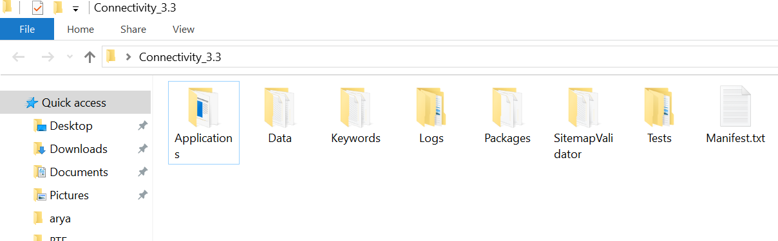
Folder Structure

Slide 5
How simple is robot framework?
Consider a simple scenario
Open web browser
Go to gmail.com
Enter Username and Password
Click Login Button
Home page should open
Lets write this test case in Robot Framework

Slide 6
It is this simple !!!
//OurFirstRobotTest.txt
*** Test Cases ***
Validate Login
Open Browser To Login Page
Input Username admin
Input Password password
Submit Credentials
Home Page Should Be Open
That’s it!!!

Slide 7
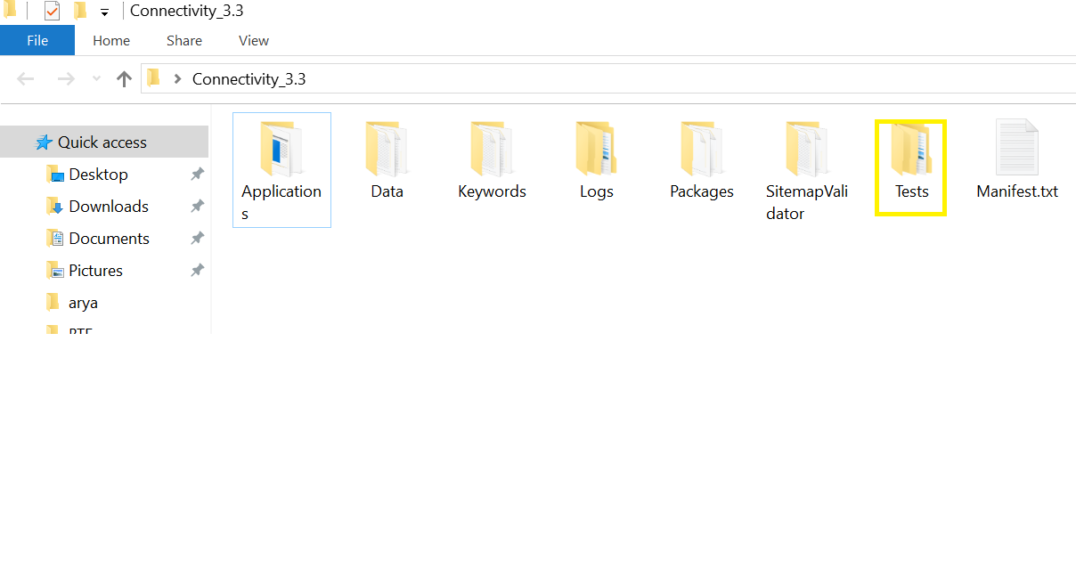
Test Case
Where is this file kept?

Slide 8
In detail…
*** Test Cases *** // It’s a test case!!!
Validate Login // Test Case Name
Open Browser To Login Page
Input Username admin
Input Password password
Submit Credentials
Home Page Should Be Open

Slide 9
In detail…
*** Test Cases *** // It’s a test case!!!
Validate Login // Test Case Name
Open Browser To Login Page
Input Username admin
Input Password password // Keywords
Submit Credentials
Home Page Should Be Open

Slide 10
In detail…
*** Test Cases *** // It’s a test case!!!
Validate Login // Test Case Name
Open Browser To Login Page
Input Username admin // Values
Input Password password
Submit Credentials
Home Page Should Be Open

Slide 11
Keywords
*** Test Cases *** // It’s a test case!!!
Validate Login // Test Case Name
Open Browser To Login Page
Input Username admin
Input Password password // Keywords
Submit Credentials
Home Page Should Be Open

Slide 12
Generic Approach
*** Test Cases *** // It’s a test case!!!
Validate Login // Test Case Name
Open Browser To Login Page
Input Username ${username}
Input Password ${password} //Variables
Submit Credentials
Home Page Should Be Open

Slide 13
Keywords
Open Browser To Login Page
How is Defined?
Where is it Defined?
How is it accessible from the test case file OurFirstRobotTest.txt?
Lets see that now…

Slide 14
Keywords
This can be defined in two ways
Directly point towards a python method
Define the keyword in a separate file and then direct towards corresponding method in python

Slide 15
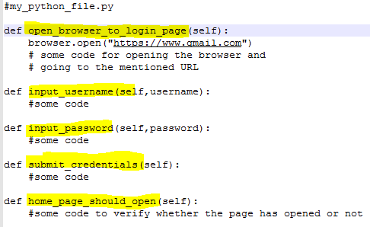
Method 1
Write a python file which has methods with the same name and define the actions to be performed (this is not recommended)
*** Test Cases ***
Validate Login
Open Browser To Login Page
Input Username admin
Input Password password
Submit Credentials
Home Page Should Be Open

Slide 16
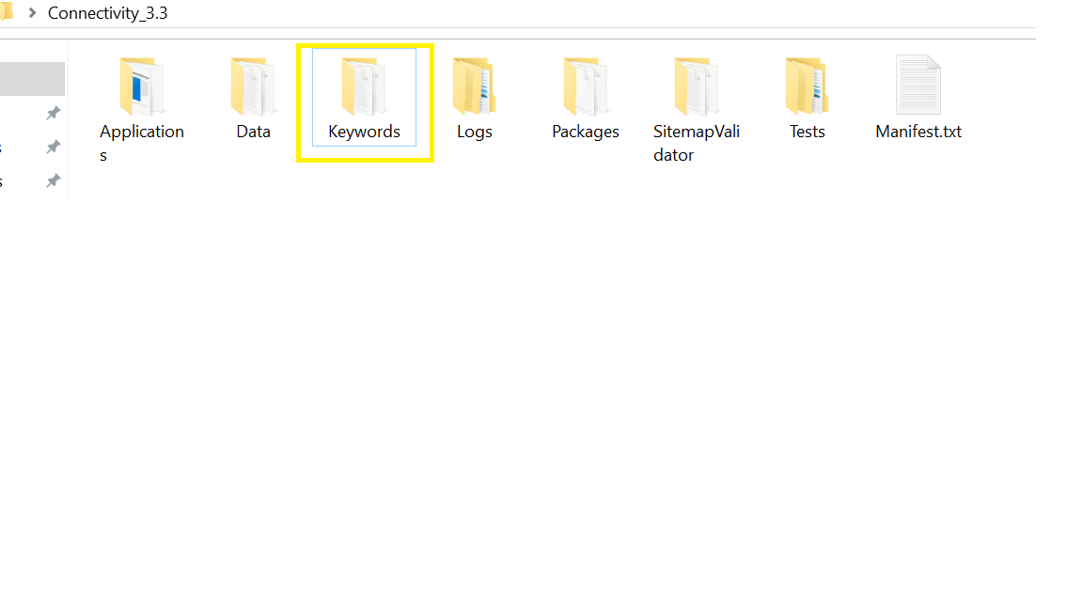
Method 2
Keywords performs a task or a set of tasks
It points towards a method in the python core library
The keywords are defined in a .txt file
It is placed here (Demo)

Slide 17
Keywords
//our_keywords.txt
***Keywords***
Open Browser To Login Page
Navigate To Login Page {url}
Input Username ${username}
Enter Username ${username}
Input Password ${password}
Enter Password ${password}
Submit Credentials
Click On Button {submit}
Home Page Should Be Open
Validate Web Page Open

Slide 18
Keywords
//our_keywords.txt
***Keywords***
Open Browser To Login Page
Navigate To Login Page {url}
Input Username ${username}
Enter Username ${username}
Variables
Input Password ${password}
Enter Password ${password}
Submit Credentials
Click On Button {submit}
Home Page Should Be Open
Validate Web Page Open

Slide 19
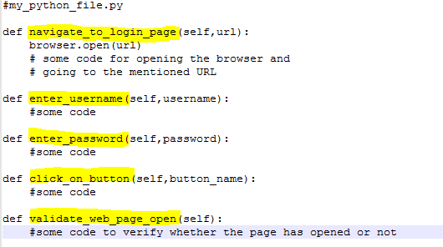
Keywords
Lets write a python file for defining these keywords

Slide 20
Keywords
//our_keywords.txt
***Keywords***
Open Browser To Login Page
Navigate To Login Page {url}
Input Username ${username}
Enter Username ${username}
Input Password ${password}
Enter Password ${password}
Submit Credentials
Click On Button {submit}
Home Page Should Be Open
Validate Web Page Open

Slide 21
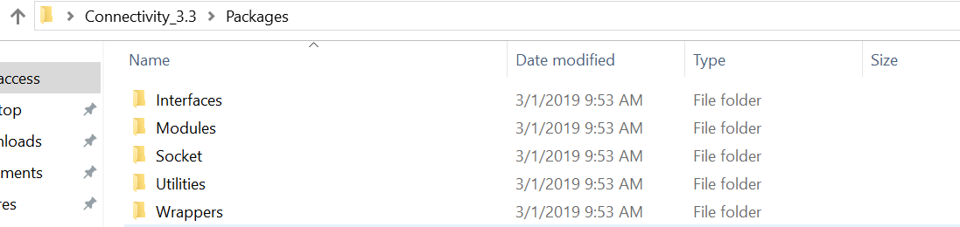
Where are these files kept?
The .py files are placed inside the Packages(Demo)
Notes:
Take a sample keyword file and explain

Slide 22
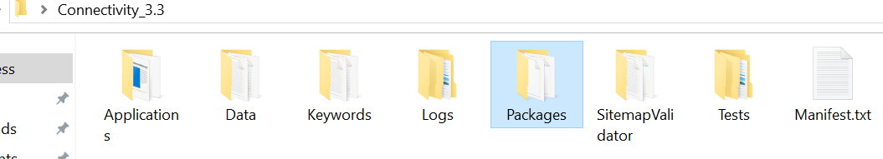
Folder Structure
For demo

Slide 23
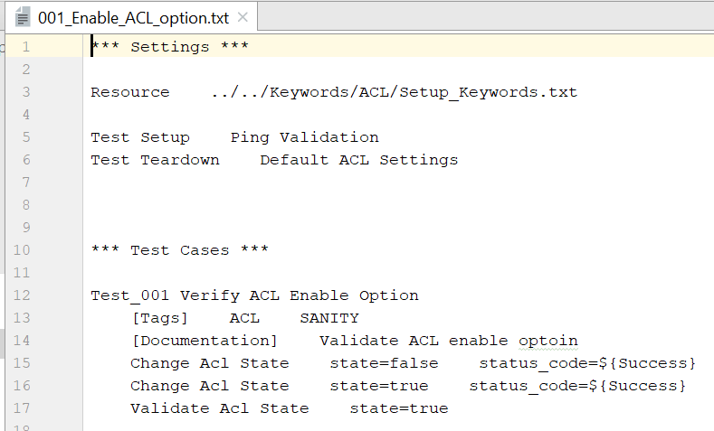
Test Case
Now lets take a look at an existing test case

Slide 24
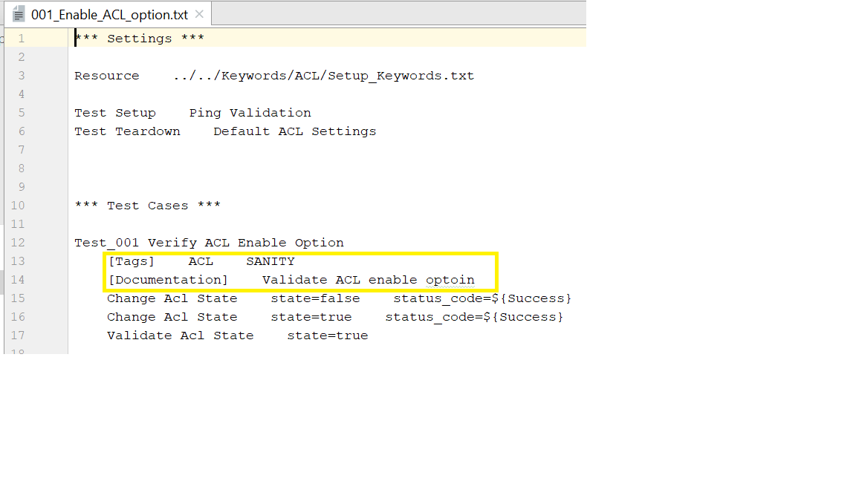
Test Case in detail
Documentation : A short description of the test case
Tags : metadata

Slide 25
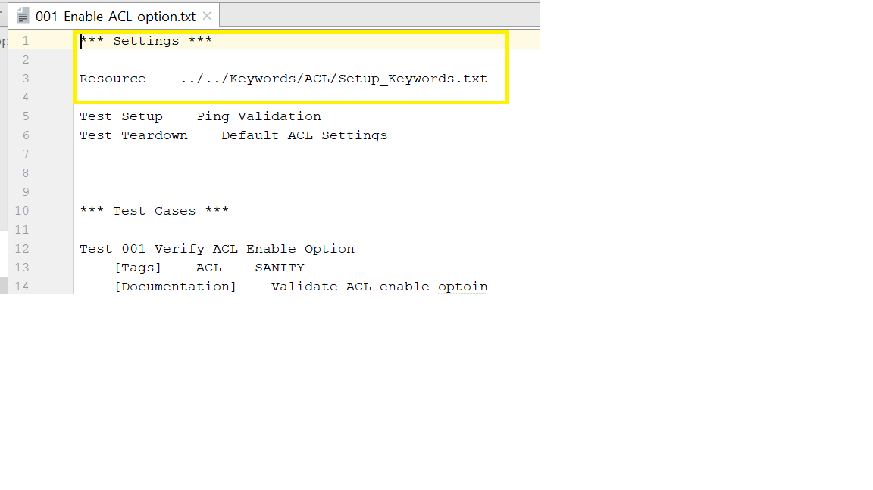
Test Case in detail
It simply means we are using the contents of the file Setup_keywords.txt

Slide 26
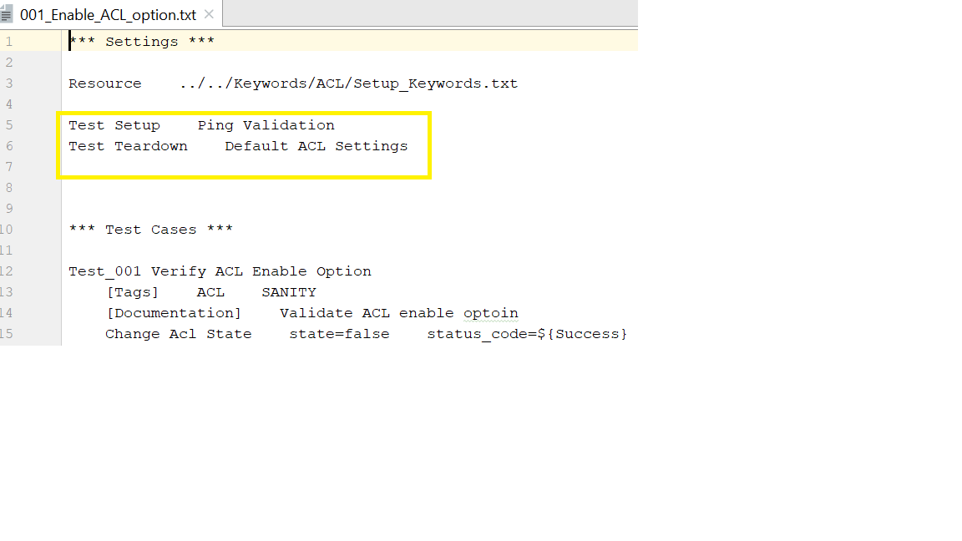
Test Case in detail
The pre-requisites and post-requisites
Notes:
Explain with the setup.txt file

Slide 27
NOTES:
Before running any test cases make sure you are using the correct IP address(ipv4 and ipv6) inside Manifest file.
Before running any EWS related test cases make sure you are using the correct sitemap for that specific printer. Also give the proper path of the sitemap file in manifest file.
For 802.1x tests give the correct switch IP address and correct port number in manifest file.
For Firewall tests first install the printer on Ubuntu and print a test page. After that run the test cases.
Before executing any test case first ping the test printer as well as open the EWS page and validate the printer condition is good to run automation.
While running SNMP test cases modify the OID files(Connectivity_3.3\Data\SNMP_Config\InkJet\product_name) with correct OID.Make sure to remove the OIDs which are causing the connectivity lost on printer.
To know more about robot framework follow the below link
https://github.com/robotframework/QuickStartGuide/blob/master/QuickStart.rst

Slide 28
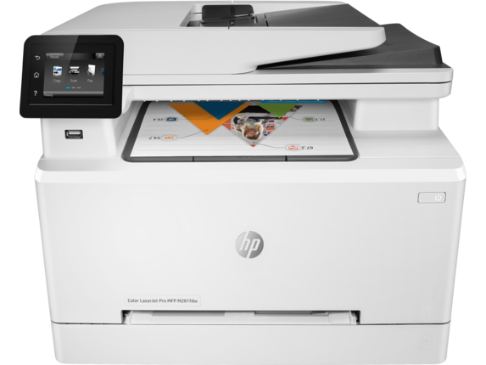
Any Questions???

